Slide 1

Sequence and collaboration diagrams

Slide 2

Interaction Diagram:
Interaction diagram consisting of arcs and set of objects their relationships including messages that pass from object to another object.
Addresses the dynamic view
It has specialized types
Sequence Diagram
Collaboration Diagram
timing diagram
interaction overview diagram

Slide 3
Interaction Diagram:
UML provides four types of interaction diagrams useful in advanced modeling.
■■ The sequence diagram shows objects interacting along lifelines, showing the general order of this interaction.
■■ The timing diagram shows interactions with a precise time axis.

Slide 4
Interaction Diagram:
■■The interaction overview diagram allows a modeler to look at the interactions from a high level. These interactions are viewed on something like
an activity diagram with many of the detailed elements not shown.
■■ The communication diagram
A communication diagram, formerly called a collaboration diagram shows the messages exchanged between objects, focusing on the internal structure of the objects.

Slide 5
Collaboration and sequence - differences
Collaboration diagram illustrates object interactions in a graph or network format, in which objects can be placed anywhere on the diagram. It demonstrates how objects are statically connected.
Sequence diagram illustrates interaction in a kind of fence format, in which each new object is added to the right. It generally shows the sequence of events that occur.

Slide 6






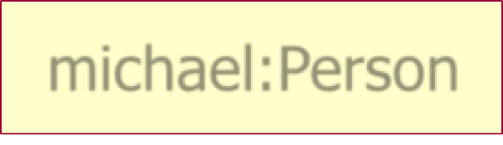

Interaction diagrams: notation
 The following notation is used in the UML for classes and
objects:
Class
Instance of a Class (object without a name)
Named instance of a class (named object)
Named object only
(shown without class)
Person
:Person
michael:Person
michael

Slide 7
Sequence diagram
Sequence Diagrams are used to show your team how objects in your program interact with each other to complete tasks.
Simply put, think of a sequence diagram like a map of conversations between different people,
where this map follows all the messages sent from person to person.

Slide 8
Sequence diagram
To fully understand it,
you should have a good grasp of objects and basic UML class diagrams.
Knowing how to break down a system into classes is essential in creating meaningful sequence diagrams.
A sequence diagram describes how objects in your system interact to complete a specific task.
Let's say that a person wants to order a burger at a local fast food restaurant

Slide 9
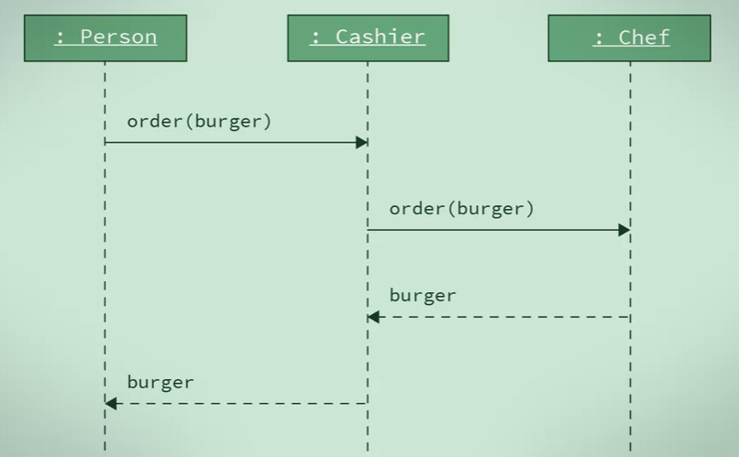
Example

Slide 10
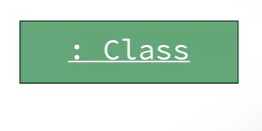
object
When creating sequence diagrams, first you use a box to represent role play by an object.
The role is typically labeled by the name of the class for the object.
each new object is added to the right draw objects from left to right in the sequence

Slide 11
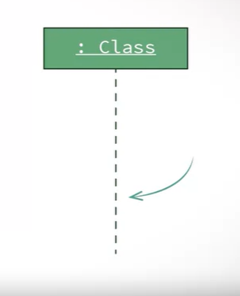
lifelines
Second, you use vertical dotted lines, known as lifelines,
to represent an object as time passes by.

Slide 12
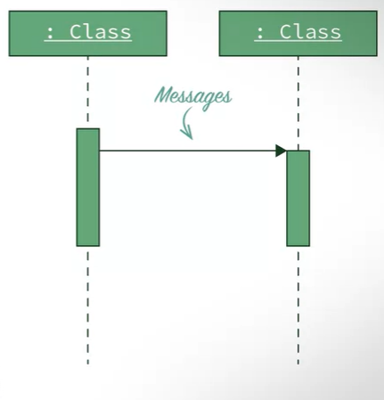
Messages
you use arrows to show messages that are sent from one object to another.
if one object sends a message to another object or objects, we denote this by drawing a solid line arrow from the sender to the receiver.

Slide 13
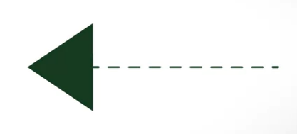
Acknowledgement
To return data and to control back to initiating objects, we would use a dotted line arrow.

Slide 14

Actor
If there are people(external objects) in your example, who will be using or interacting with objects,
this are typically draw on a stick figures.

Slide 15
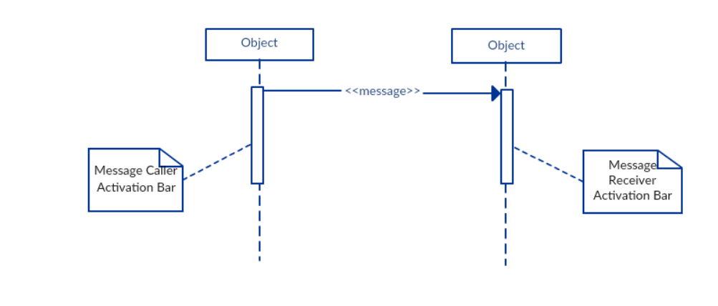
Activation Bars
When an object is activated, we denote this on our sequence diagram using small rectangles on the objects lifeline. The length of the rectangle indicates the duration of the objects staying active.
You activate an object whenever an object sends, receives or it's waiting for a message.

Slide 16
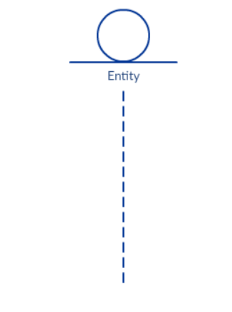
entity element
A lifeline with an entity element represents system data. For example, in a customer service application, the Customer entity would manage all data related to a customer.

Slide 17
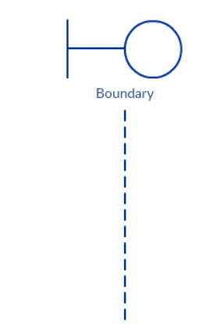
boundary element
A lifeline with a boundary element indicates a system boundary/ software element in a system; for example, user interface screens, database gateways or menus that users interact with, are boundaries.

Slide 18
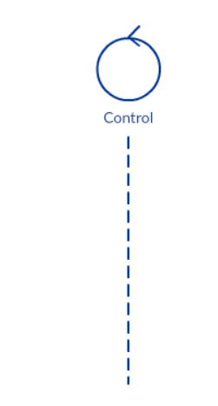
control element
And a lifeline with a control element indicates a controlling entity or manager. It organizes and schedules the interactions between the boundaries and entities and serves as the mediator between them.

Slide 19
example
Let's use changing the channel of your television using a remote control.
What objects are important in this example?

Slide 20
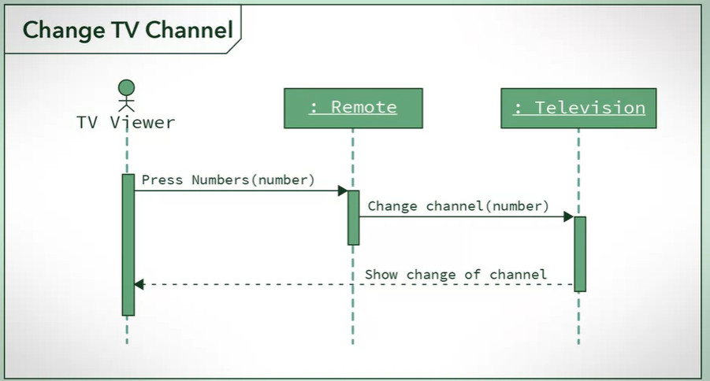
example

Slide 21
Sequence diagrams
A sequence diagram shows relations between objects.
It should be read from left to right and from top to bottom.
At the top of the diagram are names of objects that interact with each other. These are the concepts in the conceptual model.
When the course of events is initiated by an actor the actor symbol is displayed as the leftmost object.

Slide 22

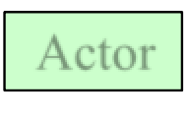
Sequence diagrams: an example
d : class
: o bject2
: object3
: Custom er
Actor
Instances
of classes

Slide 23

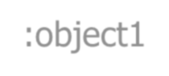
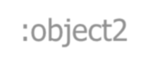
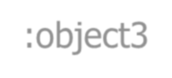


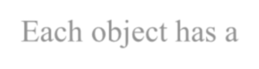
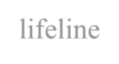

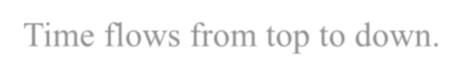
:object3
Sequence Diagram: Lifelines
:object1 :object2
:actor
Time
Each object has a lifeline. Time flows from top to down.

Slide 24
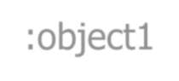
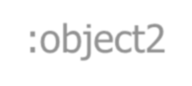
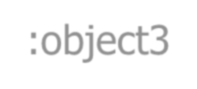


Sequence diagrams: rectangles
:object1 :object2
:object3
:actor
Time
Rectangles refer to events that are related to each other.

Slide 25

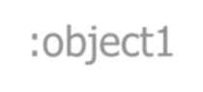
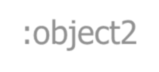
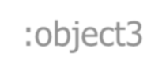


Sequence diagrams: messages
:object1 :object2
:object3
:actor
Time
Arrows indicate messages that are sent from one object to another.

Slide 26
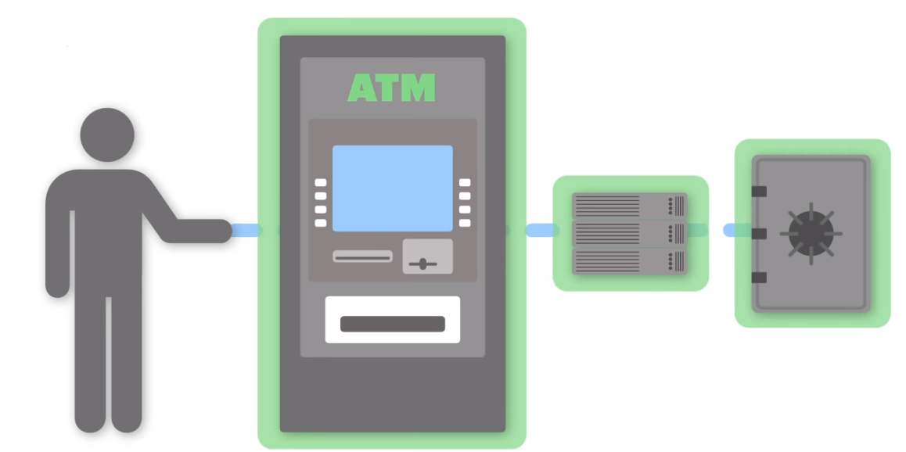
Example: ATM System
Parts of ATM
3 Objects: ATM, Bank Server, Bank Account
Person is external to the system
Actor

Slide 27
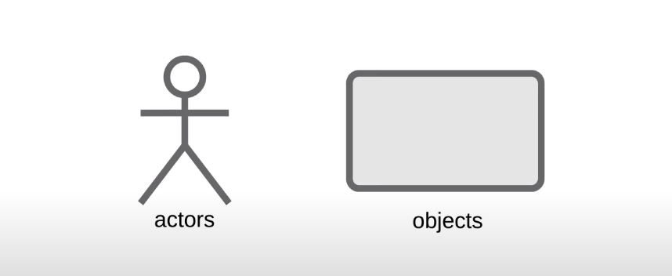
Representation

Slide 28
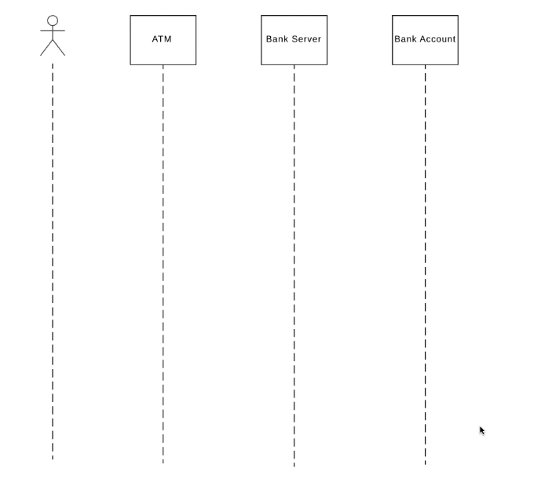
Life line

Slide 29
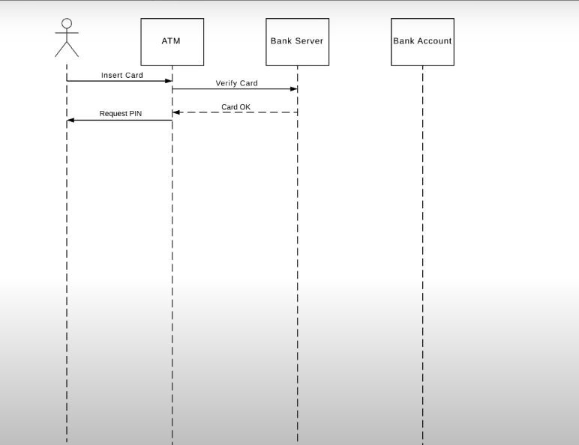
Activities

Slide 30
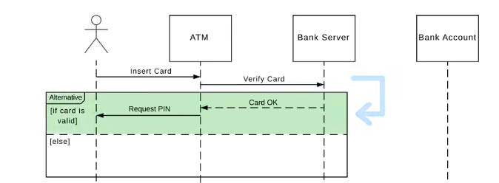
Alternative Frame

Slide 31
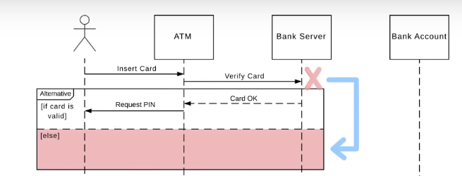

Slide 32
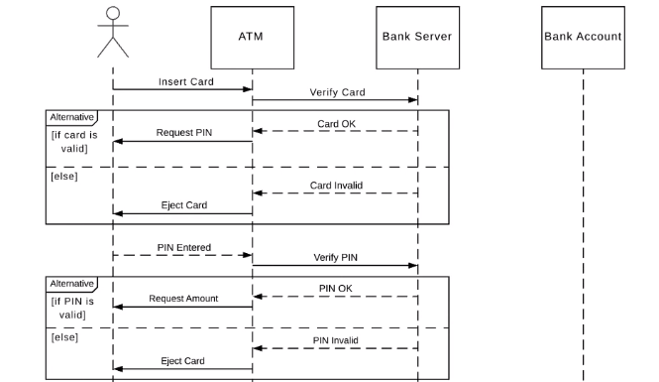

Slide 33
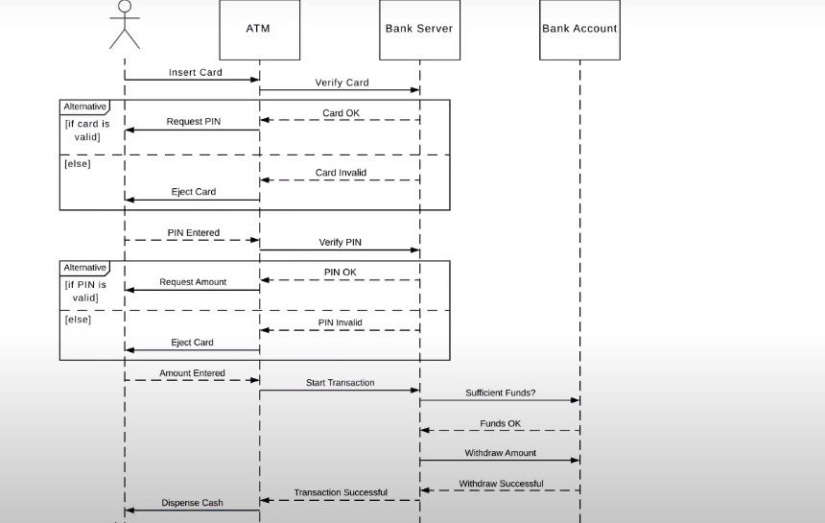

Slide 34
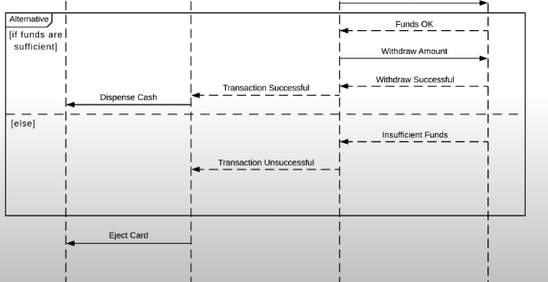

Slide 35
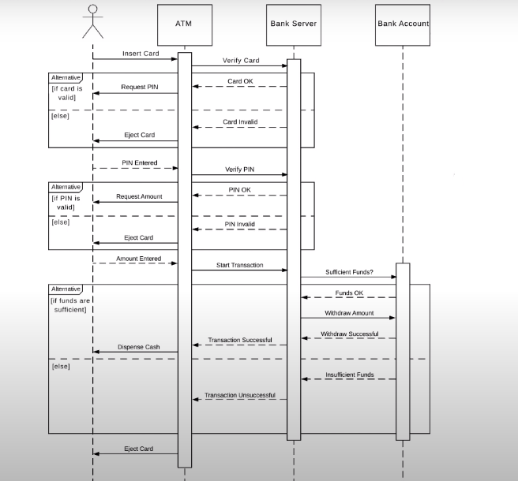
Activation Box

Slide 36
Task
Create a UML sequence diagram that will show your clients how the system’s classes will interact when customers are buying their flight tickets on the booking website.
The system should allow the customer to search available flights from the database by inputting their desired location and departure/arrival date. The website will search the database and return the available flights to display. Once the customer has chosen the flight, they will add the flight to their cart and checkout. They will also then input their payment information and once everything is complete, the website should confirm the flight, empty cart and lastly display a confirmation of the ticket for the flight.

Slide 37
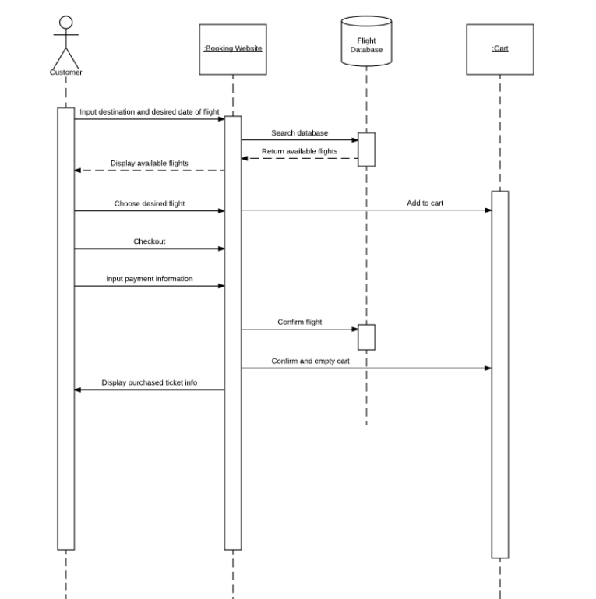

Slide 38
Message type | Description | Example
Create | A create message represents the creation of an instance in an interaction. The create message is represented by the keyword «create». The target lifeline begins at the point of the create message. | In a banking scenario, a bank manager might start a credit check on a client by sending a create message to the server.
Destroy | A destroy message represents the destruction of an instance in an interaction. The destroy message is represented by the keyword «destroy». The target lifeline ends at the point of the destroy message, and is denoted by an X. | A bank manager, after starting a credit check, might close or destroy the credit program application for a customer.
Synchronous call | Synchronous calls, which are associated with an operation, have a send and a receive message. A message is sent from the source lifeline to the target lifeline. The source lifeline is blocked from other operations until it receives a response from the target lifeline. | A bank teller might send a credit request to the bank manager for approval and must wait for a response before further serving the customer.
Asynchronous call | Asynchronous calls, which are associated with operations, typically have only a send message, but can also have a reply message. In contrast to a synchronous message, the source lifeline is not blocked from receiving or sending other messages. You can also move the send and receive points individually to delay the time between the send and receive events. You might choose to do this if a response is not time sensitive or order sensitive. | A bank customer could apply for credit but can receive banking information over the phone or request money from an ATM, while waiting to hear about the credit application.

Slide 39
Lost and found | A lost message is a message that has a known sender but the receiver is not known. A found message is a message that does not have a known sender but has a receiver. | An outside actor sends a message to a bank manager. The actor is outside the scope of the sequence diagram and is therefore a found message. A lost message can occur when a message is sent to an element outside the scope of the UML diagram.

Slide 40
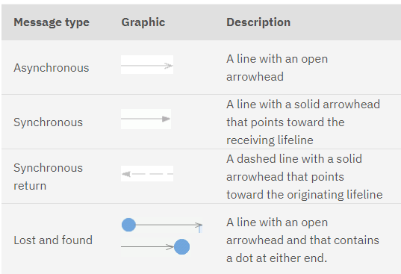

Slide 41
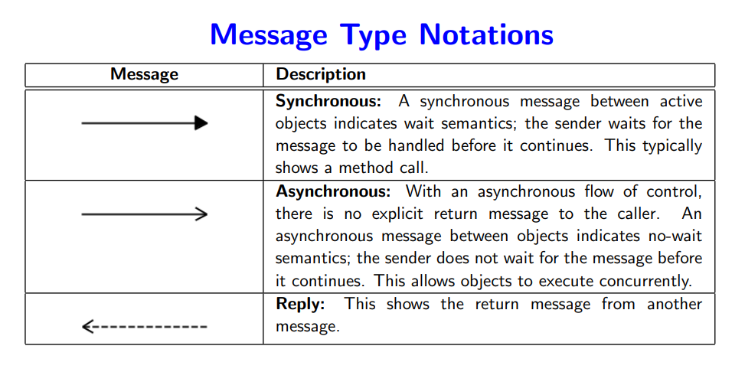
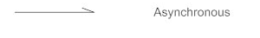

Slide 42
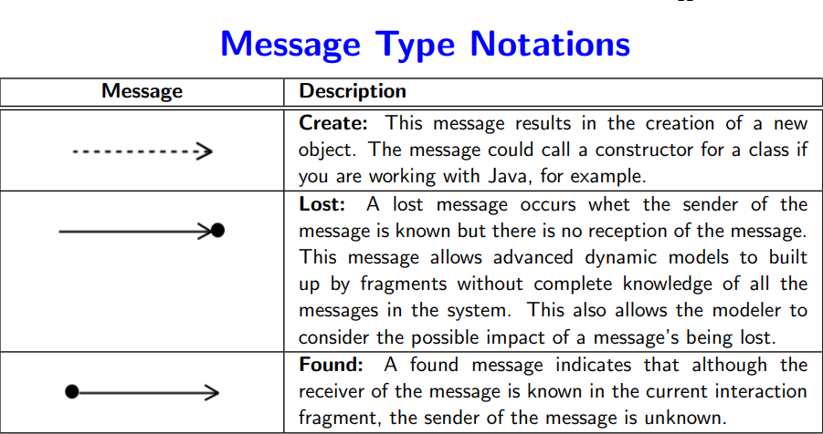
Message type notations
Lost. A lost message occurs when the sender of the message is known but there is no reception of the message. This message allows advanced dynamic models to be built up by fragments without complete knowledge of all the messages in the system. This also allows the modeler to consider the possible impact of a message’s being lost.

Slide 43
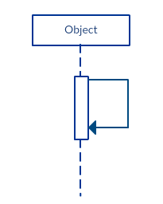
Message type notations
reflexive message: When an object sends a message to itself, it is called a reflexive message. It is indicated with a message arrow that starts and ends at the same lifeline as shown in the example below.

Slide 44


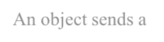


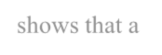
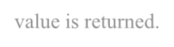
Sequence diagrams - different types of messages
: obje ct1 : o bject2 : obje ct3
: Custom e r
re q ue s t( )
cre ate Obje ct3( )
Message
cre ate ( )
An object sends a
message to itself.
Feedback arrow shows that a value is returned.

Slide 45

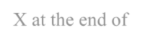

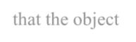

Sequence diagrams: endpoints
: obje ct1
: o bject2
: obje ct3
: Custom e r
re q ue s t( )
cre ate Obje ct3( )
cre ate ( )
X at the end of the lifeline shows that the object ceases to exist.

Slide 46
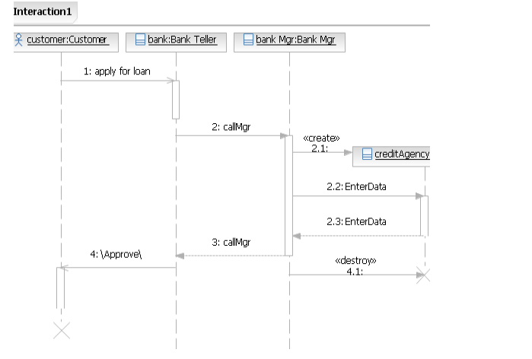

Slide 47
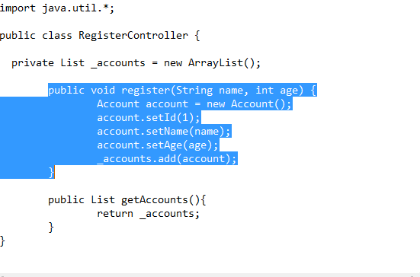
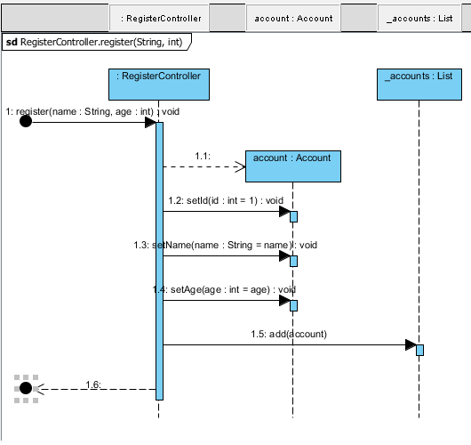
Generate Sequence Diagram

Slide 48
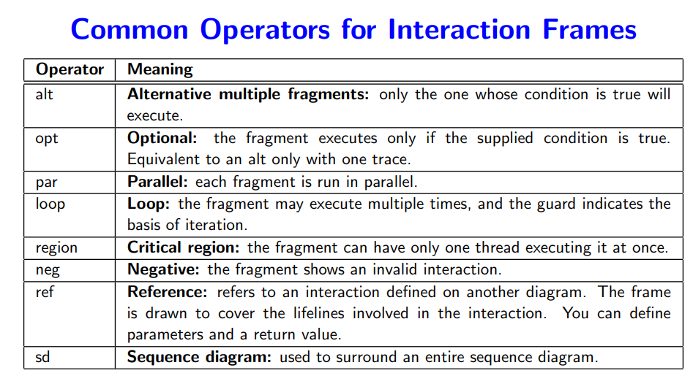
Frames in UML Sequence Diagram:

Slide 49
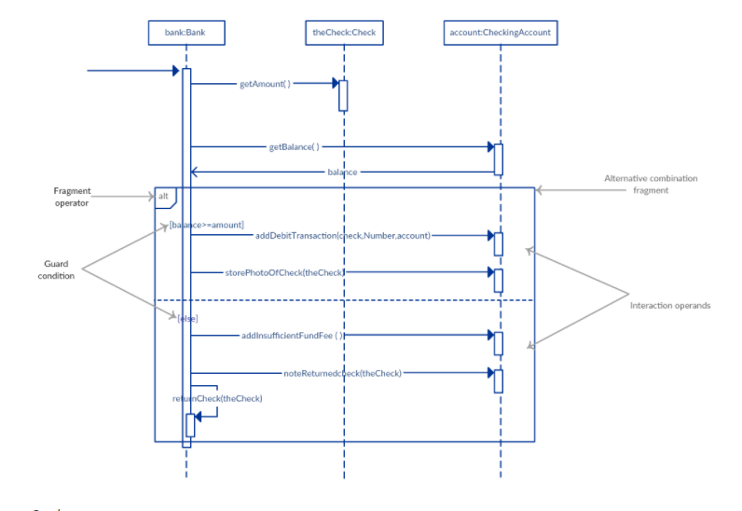
Alternatives: alt

Slide 50


Slide 51


Slide 52
Sequence diagrams - strengths and weaknesses
Strengths:
they clearly show sequence or time ordering of messages
the notation is rather simple
Weaknesses:
forced to extend to right when adding new objects, consumes a lot of space

Slide 53
Collaboration/Communication Diagram:
A collaboration diagram shows the relationship between objects and the order of messages passed between them.
The objects are listed as icons and arrows indicate the messages being passed between them.
The numbers next to the messages are called sequence numbers and, as the name suggests, they show the sequence of the messages as they are passed between the objects.

Slide 54

Communication Diagram Elements

Slide 55

Frame
Communication diagrams could be shown within a rectangular frame with the name in a compartment in the upper left corner.

Slide 56

Lifeline
A Lifeline is shown as a rectangle (corresponding to the "head" in sequence diagrams). Lifeline in sequence diagrams does have "tail" representing the line of life whereas "lifeline" in communication diagram has no line, just "head". Usually the head is a white rectangle containing name of the class after colon.

Slide 57
Objects
rectangles containing the object signature
– object signature:
object name : object Class
• object name (optional)
starts with lowercase letter
class name (mandatory)
- starts with uppercase letter
– objects connected by lines
– user (stick man) can appear

Slide 58


Messages
Messages – are labeled like C and Java function calls followed by round brackets, and can have parameters and return values are followed by an arrow to show direction internal messages are numbered, starting from 1

Slide 59
Sequence Expression
The sequence expression is a dot separated list of sequence terms followed by a colon (":") and message name after that:
sequence-expression = sequence-term '.' ':' message-name
For example, 3b.2.2:m5 contains sequence expression 3b.2.2 and message name m5.
Each sequence term represents a level of procedural nesting within the overall interaction. Each sequence-term has the following syntax:
sequence-term ::= [ integer [ name ] ] [ recurrence ]

Slide 60

Sequence Expression
For example,
message with sequence 2 follows message with sequence 1,
2.1 follows 2
5.3 follows 5.2 within activation 5
1.2.4 follows message 1.2.3 within activation 1.2.

Slide 61


Slide 62

concurrent thread
The name represents a concurrent thread of control. Messages that differ in the final name are concurrent at that level of nesting.
For example,
messages 2.3a and 2.3b are concurrent within activation 2.3,
1.1 follows 1a and 1b,
3a.2.1 and 3b.2.1 follow 3.2.

Slide 63


Slide 64
recurrence
The recurrence defines conditional or iterative execution of zero or more messages that are executed depending on the specified condition.
recurrence ::= branch | loop branch ::= '[' guard ']' loop ::= '*' [ '||' ] [ '['iteration-clause ']' ]

Slide 65

guard
A guard specifies condition for the message to be sent (executed) at the given nesting depth. UML does not specify guard syntax, so it could be expressed in pseudocode, some programming language, or something else.
For example,
2.3b [x>y]: draw() - message draw() will be executed if x is greater than y,
1.1.1 [s1.equals(s2)]: remove() - message remove() will be executed if s1 equals s2.

Slide 66

iteration notation
The * iteration notation specifies that the messages in the iteration will be executed sequentially. The *|| (star followed by a double vertical line) iteration notation specifies concurrent (parallel) execution of messages.
For example,
4.2c *[i=1..12]: search(t[i]) - search() will be executed 12 times, one after another
4.2c *||[i=1..12]: search(t[i]) - 12 search() messages will be sent concurrently,
2.2 *: notify() - message notify() will be repeated some unspecified number of times.

Slide 67
Return value
name followed by :=
Argument list
names separated by commas, within round brackets
Types of message flows

Slide 68


Slide 69


Slide 70

Multiplicity in Collaboration Diagrams
How can messages sent to a multiplicity (e.g., an array) of objects be represented?
A server object needs to send a message to each user logged in, and another message to the audit object (which keeps a track of messages sent)

Slide 71


Slide 72


Slide 73

Collaboration diagram – an example

Slide 74

Example of Collaboration Diagram “Make Payment”

Slide 75

How to read “Make Payment” Collaboration Diagram
The message makePayment is sent to an instance of Register. The sender is not identified.
The Register instance sends the makePayment message to a Sale instance.
The Sale instance creates an instance of a Payment.

Slide 76

Common Interaction Diagram Notation
Illustrating Classes and Instances:
To show an instance of a class, the regular class box graphic symbol is used, but the name is underlined. Additionally a class name should be preceded by a colon.
An instance name can be used to uniquely identify the instance.

Slide 77

Collaboration Diagram Notation:
Links, Messages and Return Value

Slide 78


Collaboration Diagram Notation:
Messages to “Self” or “This”

Slide 79


Collaboration Diagram Notation:
Message Number Sequencing

Slide 80

Continue…

Slide 81

Collaboration Diagram Notation:
Conditional Messages
A conditional message is shown by following a sequence number with a conditional clause in square brackets, similar to the iteration clause.
The message is sent only if the clause evaluates to true

Slide 82

Collaboration Diagram Notation:
Mutually Exclusive Conditional Paths

Slide 83


Collaboration Diagram Notation:
Iteration or Looping

Slide 84


Collaboration Diagrams
 Collaborations Diagrams show transient exists between objects.
 <<self>> - A message from object to itself
links
that
<< local>> - A message sent due to the object begin defined as a local variable in the method.
<<parameter>> - The object reference was sent as a
parameter to the method.
<<global>> The object is global.
37

Slide 85


Collaboration – Hotel reservation system

Slide 86

Consider the software that controls a very simple cellular telephone. Such a phone has buttons for dialing digits, and a “send” button for initiating a call. It has “dialer” hardware and software that gathers the digits to be dialed and emits the appropriate tones. It has a cellular radio that deals with the connection to the cellular network. It has a microphone, a speaker, and a display

Slide 87
Use case: Make Phone Call
1.User presses the digit buttons to enter the phone number.
2. For each digit, the display is updated to add the digit to the phone number.
3. For each digit, the dialer generates the corresponding tone and emits it from the speaker.
4. User presses “Send”
5. The “in use” indicator is illuminated on the display
6. The cellular radio establishes a connection to the network.
7.The accumulated digits are sent to the network.
8. The connection is made to the called party.

Slide 88


Slide 89
One of the greatest strengths of collaboration diagrams is their simplicity.
The principal weakness, however, is that although they are good at describing behavior, they do not define it. They typically do not show all the iteration and control that is needed to give an computationally complete description.

